Slide 1
Adversarial Attacks
Kim Seung Hwan (overnap@khu.ac.kr)
2022-09-02

Slide 2
What is an Adversarial examples?
An image with appropriate perturbation to misclassify
Using these to fool the model is called an Adversarial attack

Slide 3
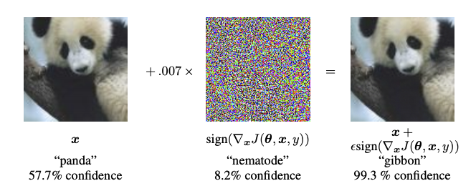
What is an Adversarial examples?
One of the important properties of the examples is that the perturbation should NOT be identified by humans
So this is also how to make difficult samples
i.e., It can be viewed as a kind of argumentation

Slide 4
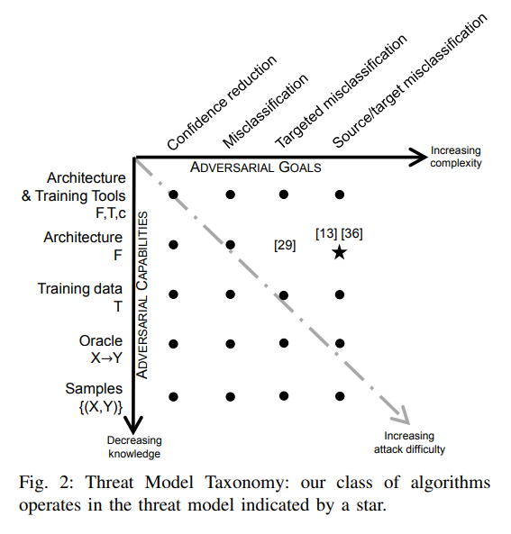
Types of Adversarial attacks
The attacks can be classified into two categories:
1. Capability level
2. Goal level

Slide 5
White-box attack
FGSM is a way to make perturbations that cause (untargeted) misclassification when you know everything about model
It uses the gradient to move the loss increase

Slide 6
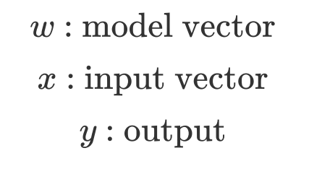
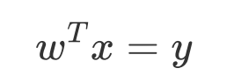
Fast Gradient Sign Method
“Explaining and Harnessing Adversarial Examples” (Goodfellow et al. 2015)
Consider a linear model
All model w/o nonlinear effects can be express as linear combinations of input features as:

Slide 7
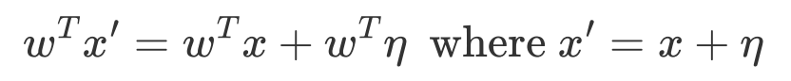
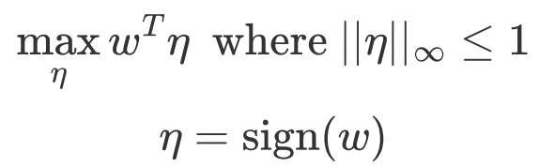
Fast Gradient Sign Method
Maximize the impact of the perturbation
Subject to the max norm constraint

Slide 8
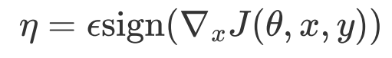
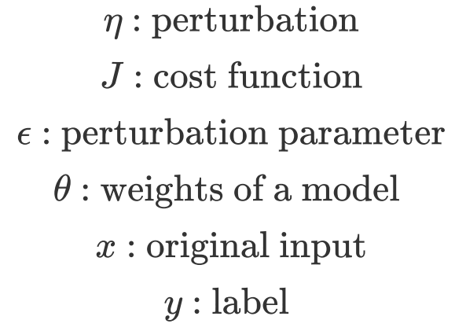
Fast Gradient Sign Method
Assume that the cost function is linear around the current theta
The perturbation can be optimized in the same way in nonlinear model

Slide 9
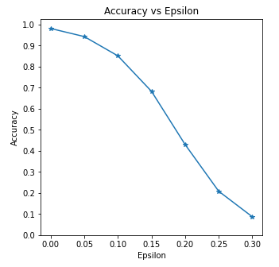
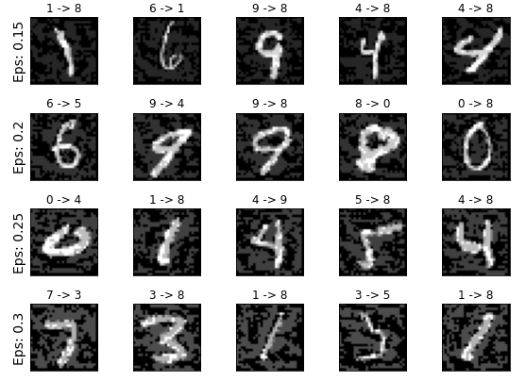
FGSM w/ MNIST

Slide 10
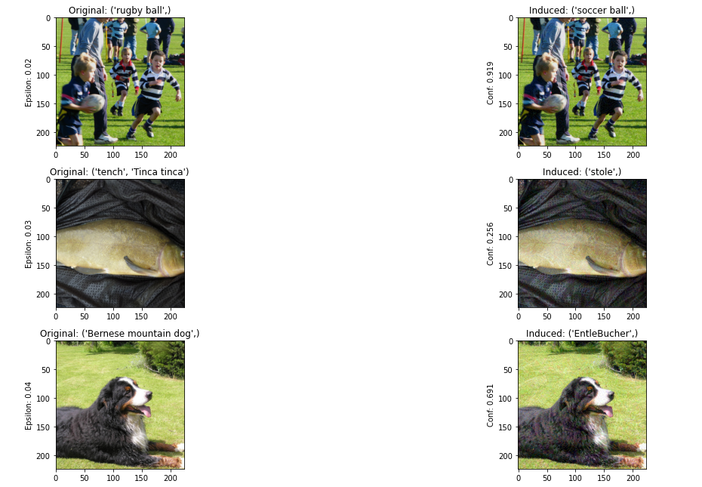
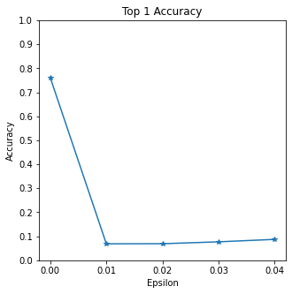
FGSM w/ ImageNet

Slide 11
Black-box attack
Only knows the training set, the probability or logit
Or worse the predicted label

Slide 12
Black-box attack
Of course, it is more challenging than white-box attack
It can be viewed, however, as a more realistic attack
Many commercial models only give probabilities or labels
If we make huge queries to the model, the service provider will be able to detect us easily
Therefore, in black-box attack, minimizing the number of queries becomes an important issue

Slide 13
Taxonomy of Black-box Attack
Gradient-based methods
Optimization-based methods
Transfer-based methods

Slide 14
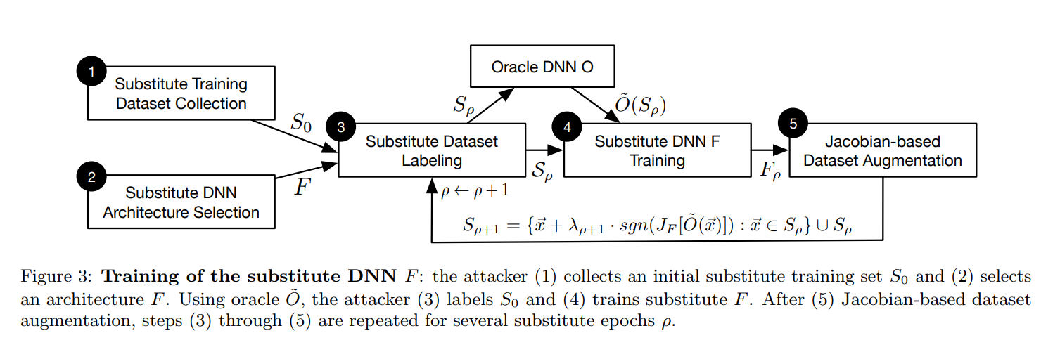
Transfer-based method
“Practical Black-Box Attacks against Machine Learning” (Papernot et al. 2017)
Train a substitute model, and generate adversarial examples with the replacement model

Slide 15
Transfer-based method
Assume that the attacker collected the dataset by hand
The dataset is very small, and its distribution may be different
Authors claim Jacobian-based augmentation solves this
The augmentation does not significantly increase the accuracy; but increase the success rate of attack

Slide 16
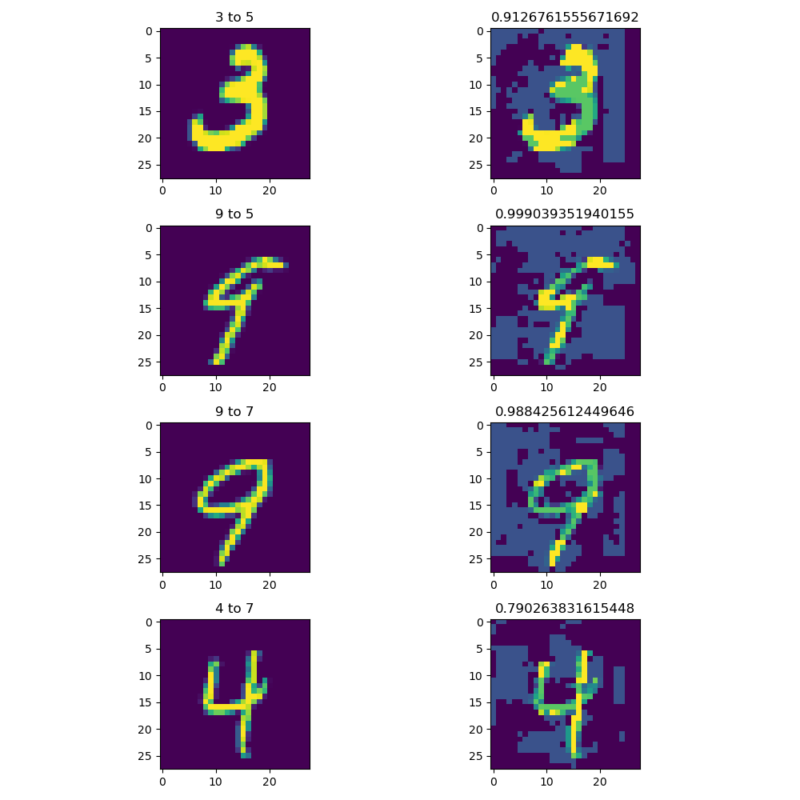
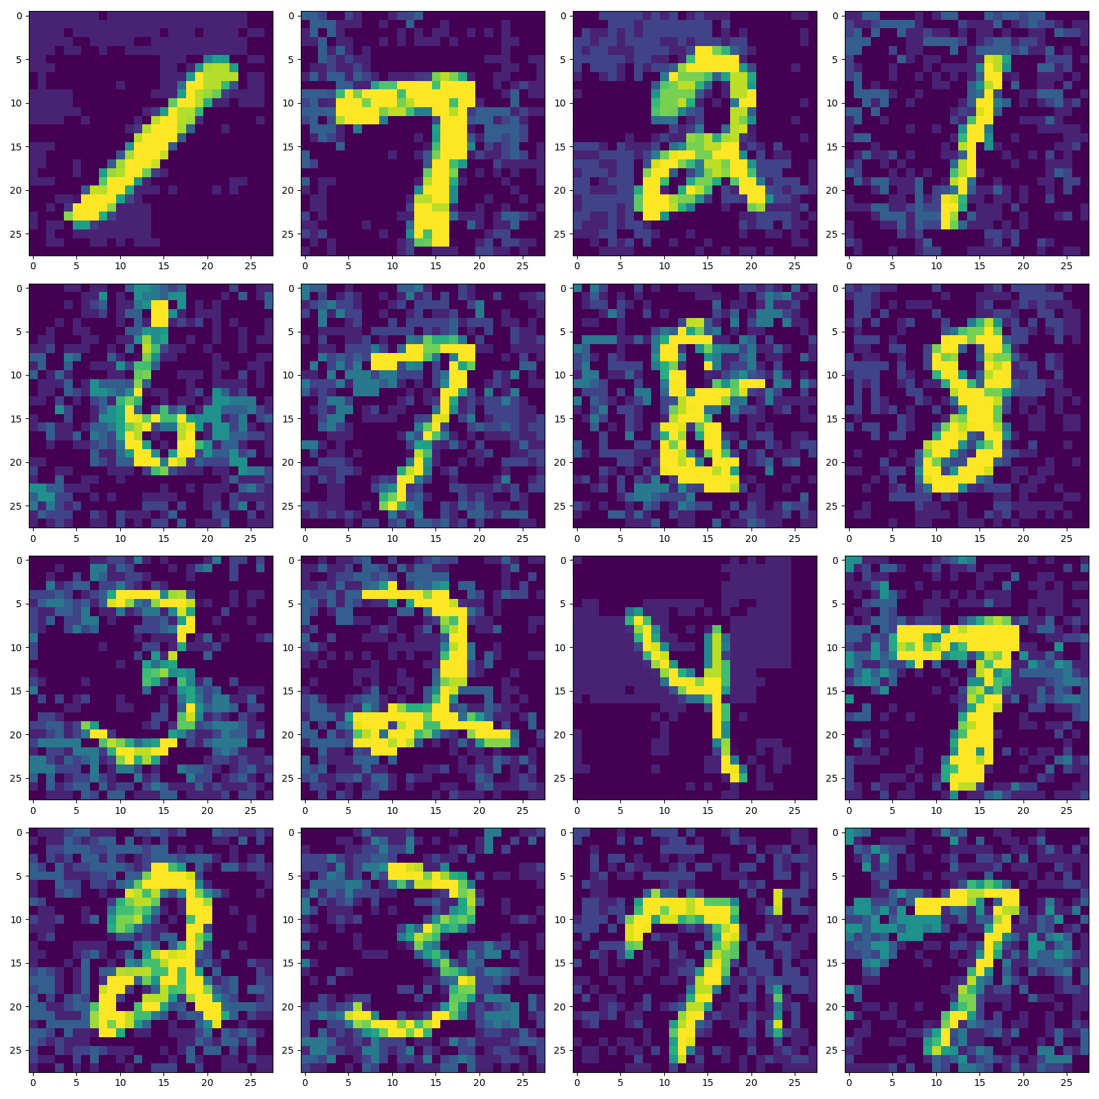
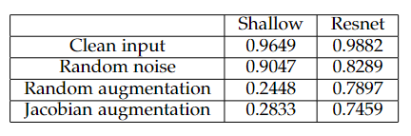
Transfer-based method w/ MNIST

Slide 17
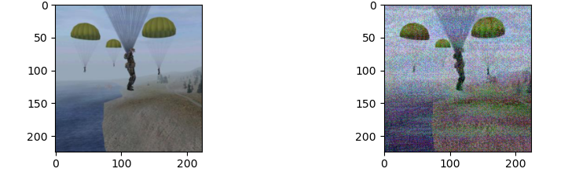
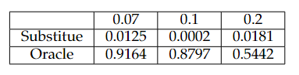
Transfer-based method w/ ImageNet

Slide 18
Discussion 1
The black-box attack performed better on shallow CNN
The white-box attack worked well even with complex models and datasets
I think this is because the decision boundary is simple
The black-box targeted attack will be even more challenging

Slide 19
Discussion 2
Jacobian-based augmentation was not effective
It also produce different results depending on the intensity parameter
The method only use sign of Jacobian; Why?

Slide 20
Discussion 3
Resnet is vulnerable to random noise compared to the shallow CNN
I think this is because the model is overly complex for the task; The dataset was MNIST

Slide 21

Discussion 4
What is the appropriate perturbation metric?
$L_{2}$ norm, $L_{∞}$ norm
Euclidean is very intuitive, but does not match real human perception

Slide 22
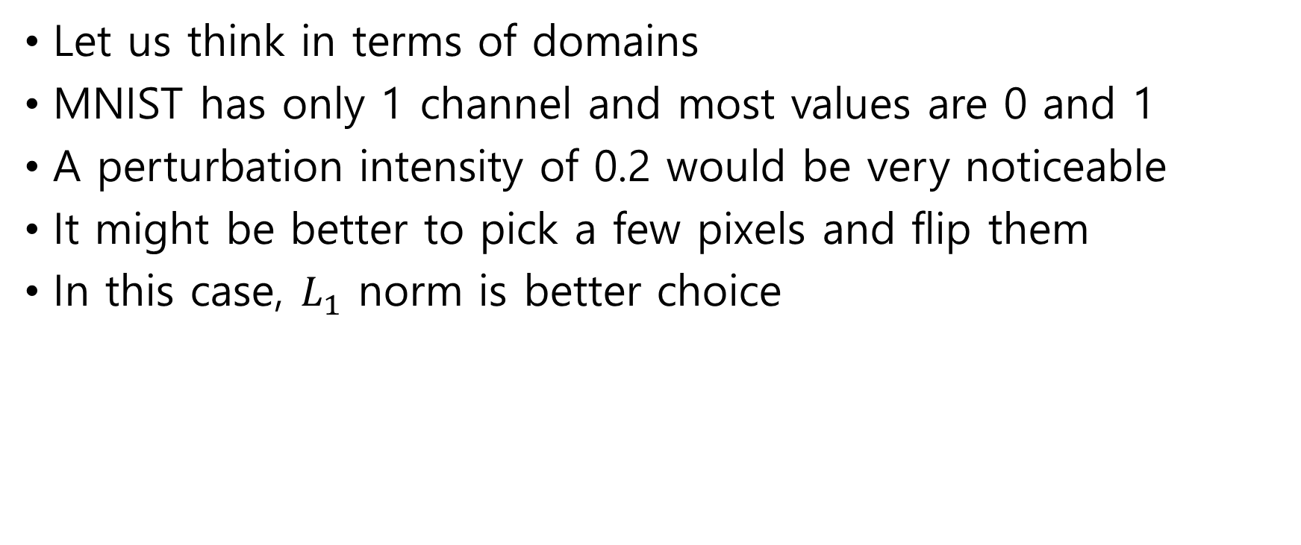
Discussion 4
Let us think in terms of domains
MNIST has only 1 channel and most values are 0 and 1
A perturbation intensity of 0.2 would be very noticeable
It might be better to pick a few pixels and flip them
In this case, $L_{1}$ norm is better choice

Slide 23
Discussion 5
Adversarial defences are usually expensive, and there is no visible accuracy improvement for clean input
For example, the simplest defence is to learn adversarial examples
But this is very expensive and can be easily circumvented with R-FGSM (Tramèr et al. 2018) etc.

Slide 24
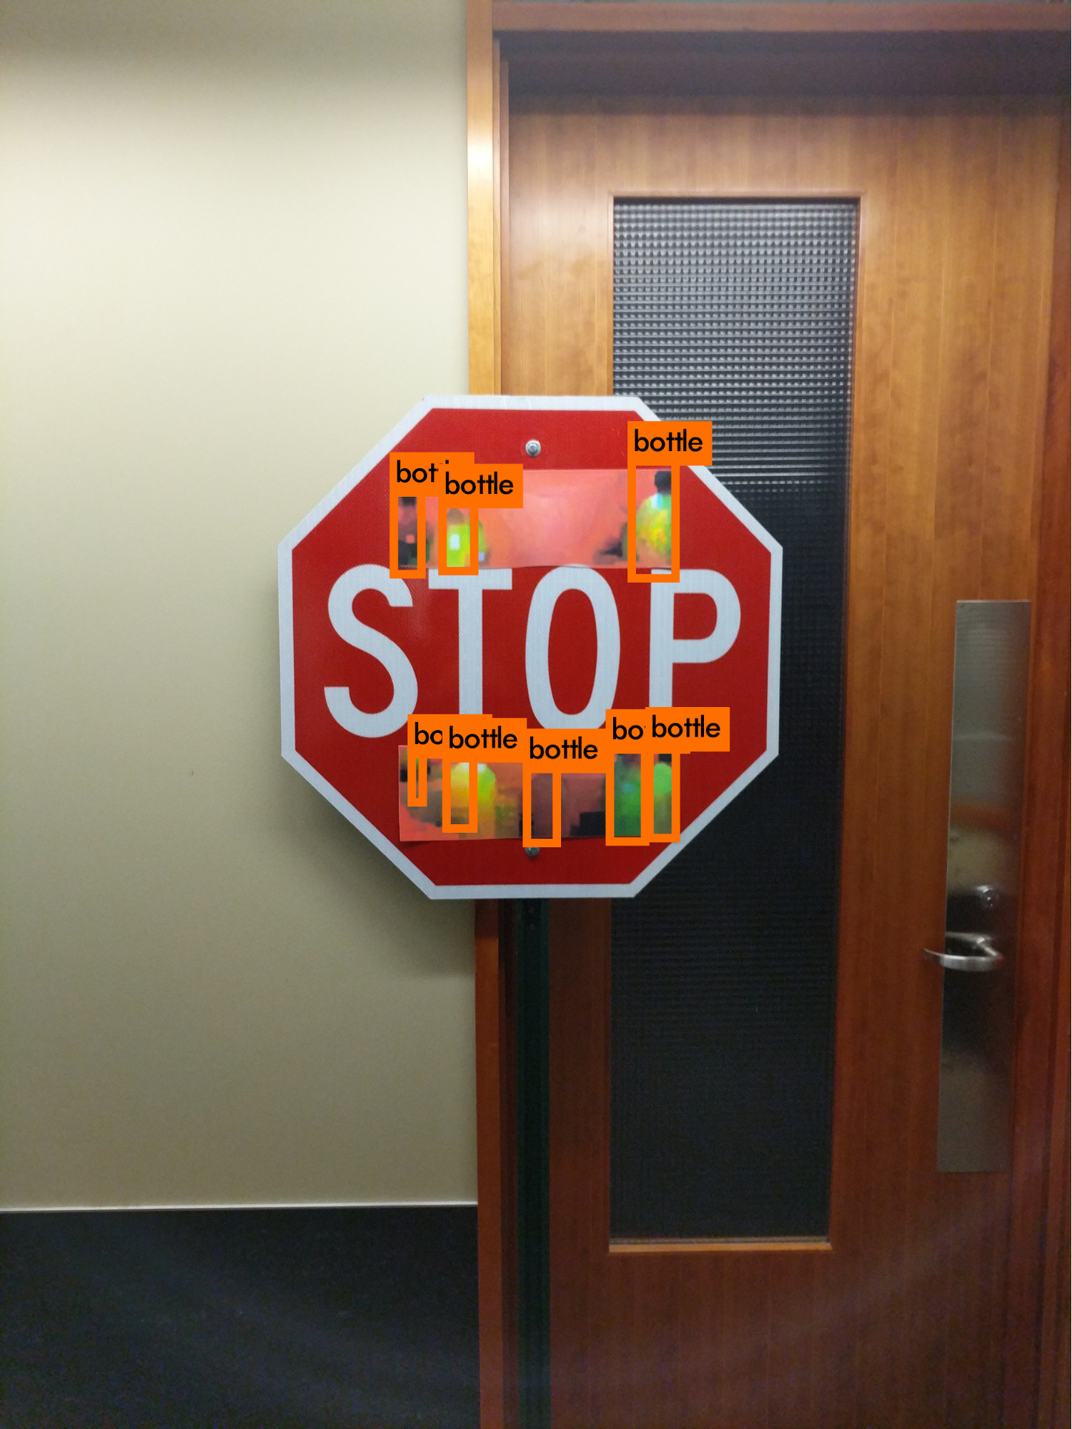
Discussion 5
The cheaper way is to use domain
Binarize the input on MNIST or denoise in ImageNet
There are so many ways to attack and to defend
Adversarial attack is an unavoidable vulnerability
Specialized attacks and defences in areas where misclassification is fatal seem to be important

Slide 25
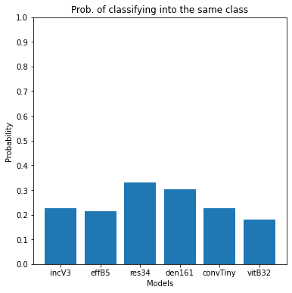
Discussion 6
It seems that there are vulnerabilities due to the structure of models and due to the dataset itself

Slide 26
Discussion 6
Is it possible to attack separately?
For example, there is a way to attack by ensemble of substitutes (Liu et al. 2017)
This can be seen as an attempt to minimize the structural part of the vulnerability
Attacking only specific model or specific datasets is an interesting future work

Slide 27
Further study
Studying later papers
Black-box attack with challenging goal in complex tasks
Attacks on the structures and on datasets separately

Slide 28
Thank You For Listening
Kim Seung Hwan (overnap@khu.ac.kr)

